Slide 1

UNIVERSITY INSTITUTE OF ENGINEERING
COMPUTER SCIENCE ENGINEERING
Bachelor of Engineering (Computer Science & Engineering)
Subject Name: Block chain Technology
Subject Code: 20_CST-412
Introduction to block chain
Mapped with CO1
Prepared By:
Er. Ankita Sharma
DISCOVER . LEARN . EMPOWER

Slide 2
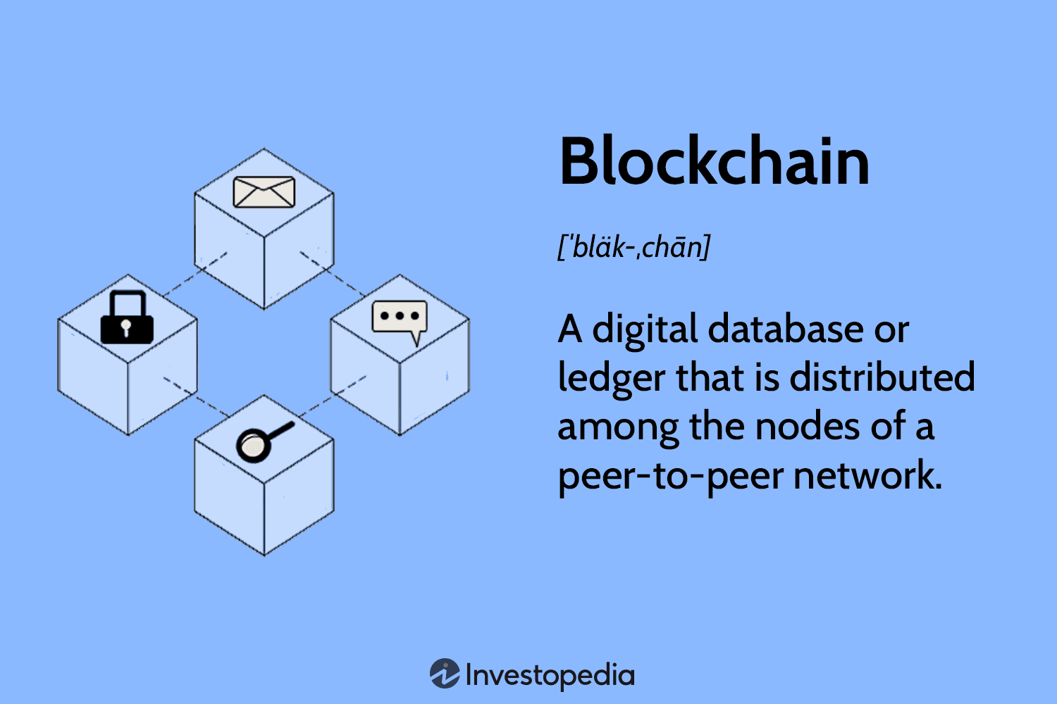

Overview of block chain technology
Block chain technology is a decentralized, distributed ledger system that enables secure and transparent transactions and information sharing across multiple parties. It was first introduced as the underlying technology behind Bitcoin, but its potential applications go far beyond cryptocurrency.

Slide 3
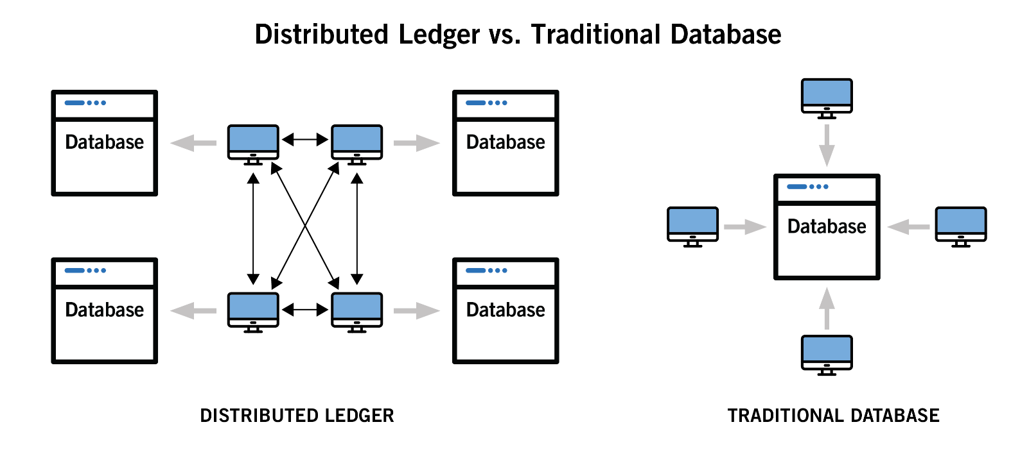
This is the main difference between traditional database and distributed ledger

Slide 4

Some key aspects pf block chain technology
Decentralization: Block chain operates on a decentralized network of computers, known as nodes, which collectively maintain and validate the block chain. There is no central authority or intermediary controlling the system, reducing the risk of single points of failure or manipulation.
Transparency and Security: The information stored on a block chain is transparent and accessible to all participants in the network. Each transaction is verified and recorded using advanced cryptographic techniques, making it difficult to alter or falsify data. This transparency and security enhance trust among participants.

Slide 5
Consensus Mechanisms: To achieve agreement on the state of the block chain, various consensus mechanisms are used, such as Proof of Work (Pow), Proof of Stake (PoS), and Delegated Proof of Stake (DPoS). These mechanisms ensure that the majority of participants agree on the validity of transactions and the order in which they are added to the block chain.
Smart Contracts: Block chain technology supports programmable contracts called smart contracts. Smart contracts are self-executing agreements with predefined rules and conditions. Once the conditions are met, the contract automatically executes without the need for intermediaries, ensuring transparency and efficiency.

Slide 6
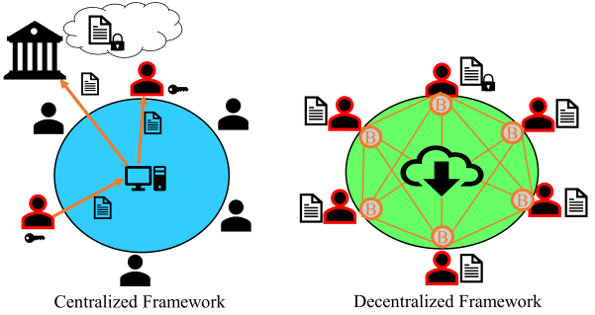
Centralization and de-Centralization
Centralization example = Google docs
Decentralization example= Bit coin block chain

Slide 7
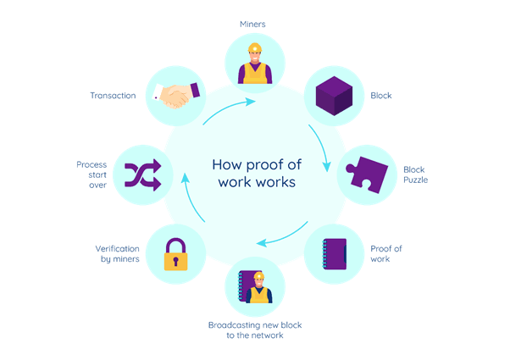

Slide 8
